Slide 1
CS 307 - CodeVA Scratch / Python SOL Development
Sternheimer Finalist Presentation
Dakota Brown, Hunter Frostick, Benjamin Napier, Kenneth Richardson, Seth Vickers
Advisor: Caroline Budwell

Slide 2
Why is this important?
Computer science leads to economic opportunity and the best careers
Computer science is foundational for every child, regardless of career
Computer science can help make school fun again
Notes:
It is estimated by the Bureau of Labor Statistics that, in 2020, the number of unfilled computer science related jobs will exceed one million, with only four hundred-thousand computer scientists applicable to apply for said jobs
four hundred years ago there was no calculus, now we learn it in high school

Slide 3
Computer science is just
about learning technology
Computer science is about logic, problem solving, and creativity

Slide 4
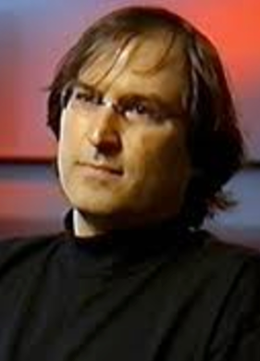
“I view computer science as a liberal art. It should be something that everybody learns, takes a year in their life, one of the courses they take.…. Because it teaches you how to think.”
— Steve Jobs, 1995

Slide 5
Changing perceptions in the last few years...
90% of parents want their child’s school to teach computer science
75% of Americans believe CS is cool in a way it wasn’t 10 years ago
50% of Americans rank CS as one of 2 most important subjects after reading and writing (70% chose math)

Slide 6
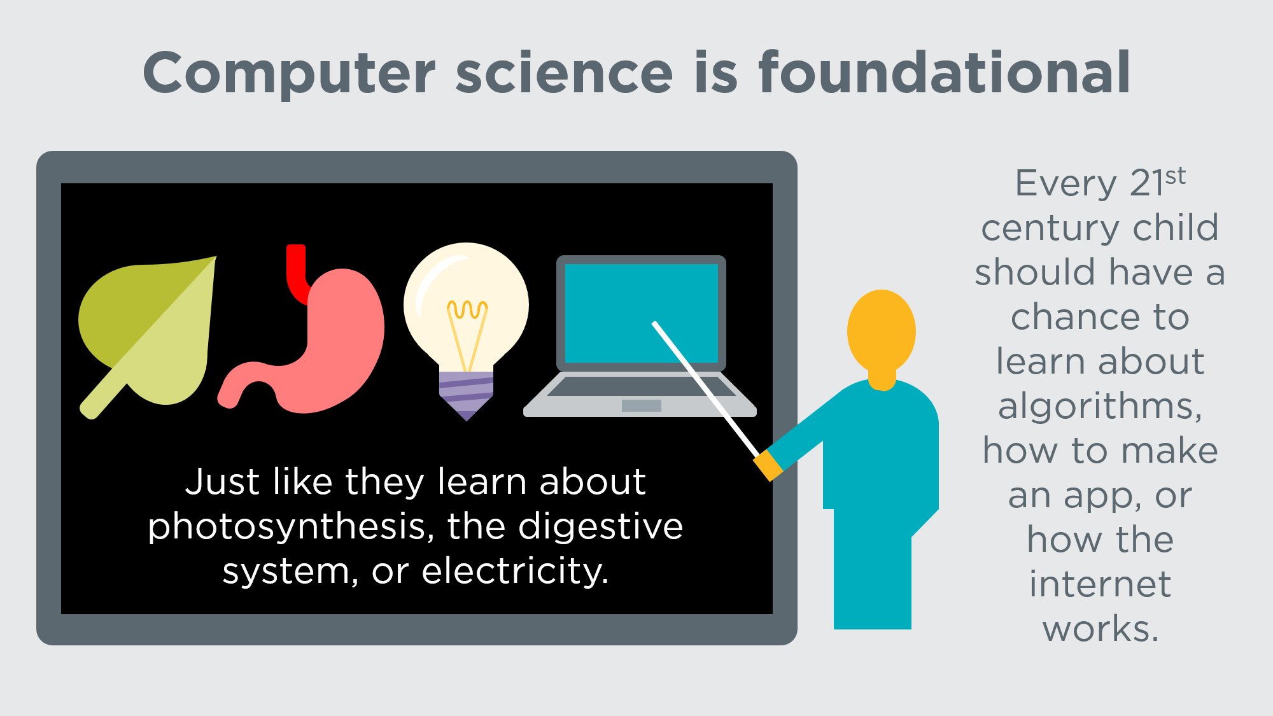

Slide 7

















Opportunity in a time of automation
Diversity of the tech workforce
Notes:
Women who learn computer science in high school are 10 times more likely to study it in university.
In 2013, the Code.org Advocacy Coalition, launched the Make Computer Science Count campaign
When computer science counts for graduation, diversity increases. URM = 26% rise, women = 24% rise
There are 2 problems we need to solve in the 21st century.
Opportunity in a time of automation when jobs are disappearing across America
AND diversity of the tech workforce – which, we all know, has major gaps

Slide 8

K-12 computer science
University computer science
Software workforce

Slide 9
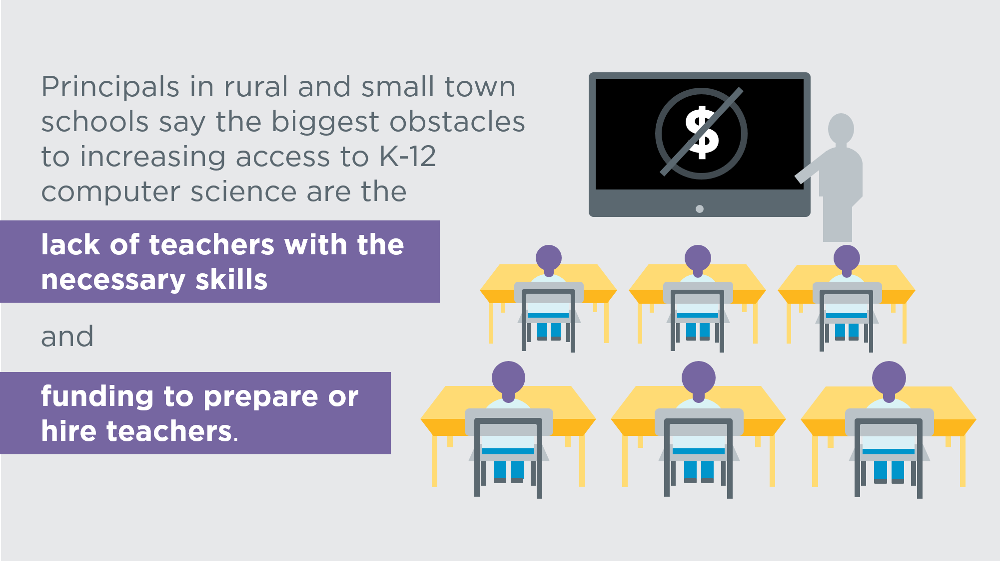

Slide 10
Computing is the fastest-growing, highest-paying, and largest sector of new jobs in the U.S.A.
In every industry, and in every state.
Notes:
67% of software jobs are outside the tech industry - banking, retail, entertainment, etc.

Slide 11
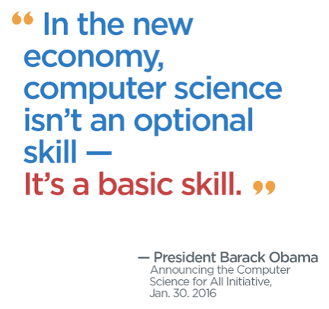
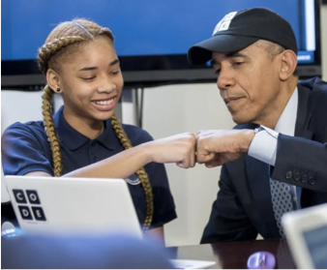

Slide 12
Thank you for your time.
Questions?
Sources used: code.org

